Slide 1
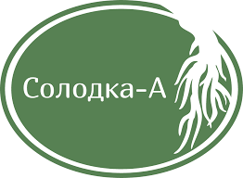
Russian company for the production of dry licorice root extract
(CGA) LLC “Solodka-A"

Slide 2
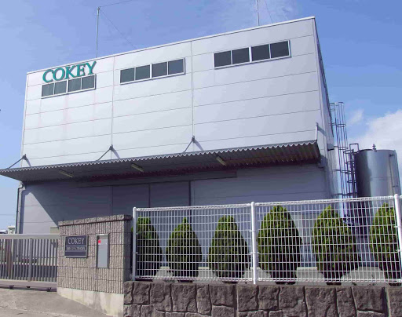
The history of the company's creation
LLC "Solodka-A" was established in January 2013, 70% of which was purchased by the Japanese company "Coca Systems" in the same year. The initial task of the production complex was the processing of licorice root with a volume of up to 2000 tons per year, followed by the production of crude glycyrrhizic acid (CGA).
To implement the project, the property of "Solodka-A" was provided with high-quality specialized equipment from Japan, as well as funds were invested to build the necessary facilities.

Slide 3
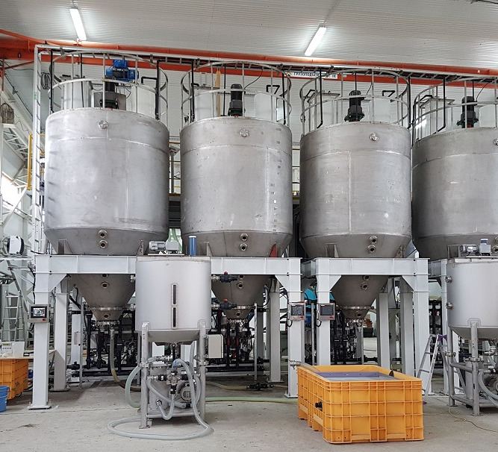
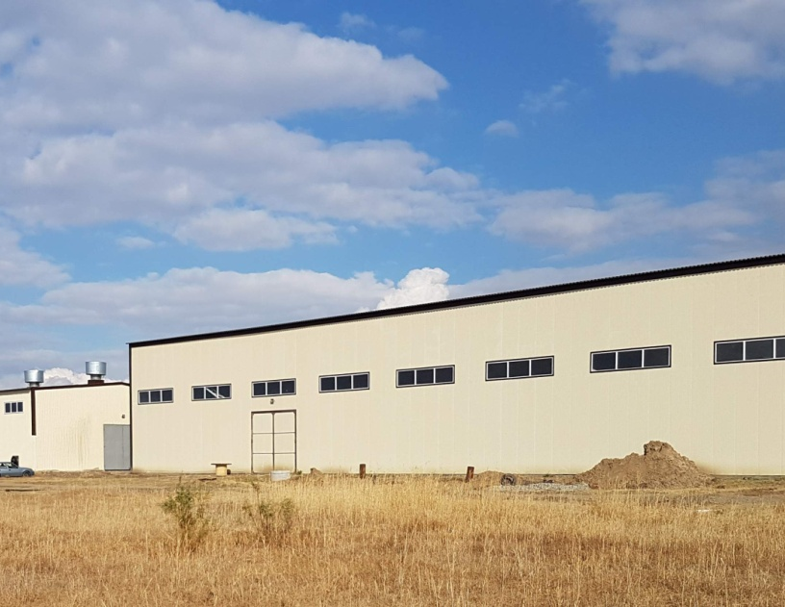
The company “Solodka-A" in 2022
At the moment, our company employs 32 people for the processing of licorice root and the production of dry licorice root extract (CGA) from it. More than 150 people in rural areas of the region are provided with work at the expense of orders placed by LLC “Solodka-A" for root extraction.
Owned by the company are: a drying storehouse with an area of 1500 sq. m., capable of accommodating about 1000 tons of licorice root; a licorice root processing plant with an area of 900 sq. m.; a canopy for drying licorice root with an area of 1000 sq. m.; an administrative and household building.

Slide 4
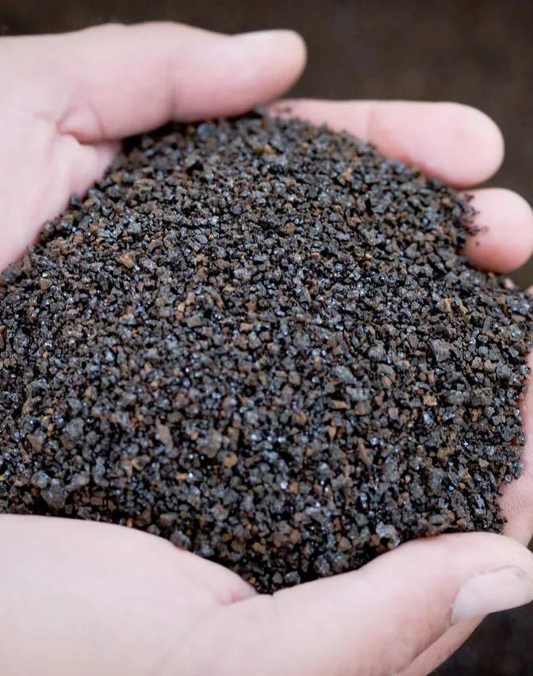
Licorice Root Dry Extract (CGA)
Dry licorice root extract produced by Licorice-A is contained in licorice (licorice) roots and has various medical uses: for the treatment of stomach ulcers; anti-inflammatory agent; anti-influenza expectorant, etc.
Glycyrrhizic acid is also used in the prevention of immune involution and cognitive disorders.
The advantages of our product include the absence of side effects.

Slide 5
Licorice Root Extract in cosmetology
One of the most common components of cosmetic care products is crushed licorice root. It is a component of anti-age creams, often found in lotions for particularly sensitive and problematic skin, in shampoos, in bleaching cosmetics, in bath foams, in hair removal products, etc.
Glycyrrhizic acid itself has an anti-allergic effect, has bactericidal and anti-inflammatory properties

Slide 6
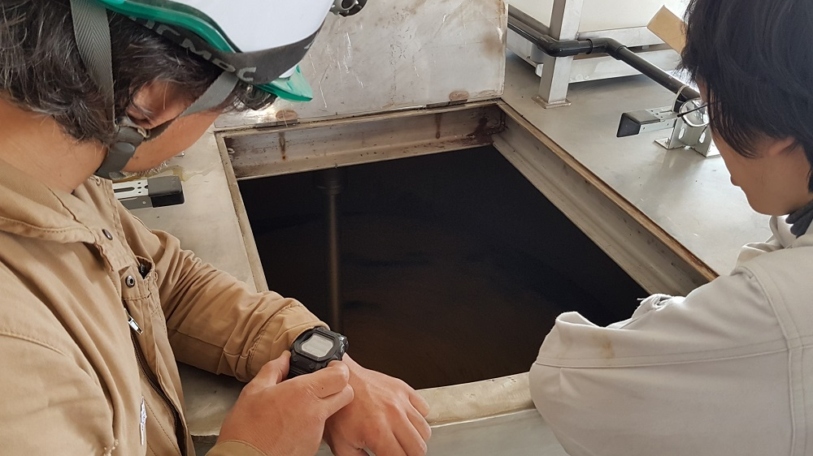
Advantages of working with«Solodka-А»
Production using innovative technologies
Our own production guarantees our partners favorable conditions for transactions
Extensive experience in foreign economic activity shows the demand for the quality of our products abroad
We have been on the market since 2013, increasing production turnover every year

Slide 7
Contacts
Director of LLC “Solodka-A":
Sinchenko Stanislav Stepanovich
Telephone:
+7 (937) 138-49-75
+7 (937) 138-51-18
Website :
http://solodka-a.ru/
E-mail:
direktor@solodka-a.ru
info@solodka-a.ru

